Slide 1
The Assembled Maze
Created by:
Steven Boyce
Luke Jenkins
Zachary Lyons
Matthew Ward

Slide 2
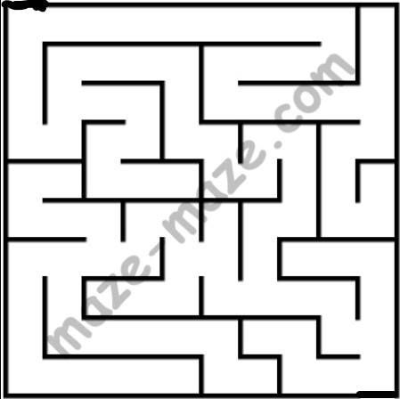
Pieces of the Maze
Introduction
The Maze
TRAP functions
Accepting Input
Ending

Slide 3
Introduction

Slide 4
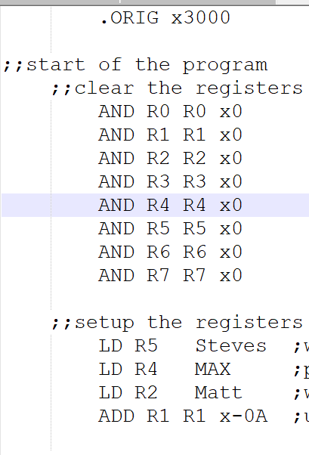

Introduction
Clear Registers
Setup Registers
R2 —> start of the maze
R4 —> length of the maze
R5 —> location of accept input subroutine

Slide 5
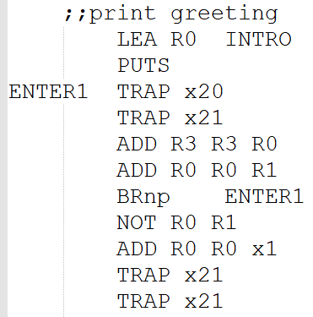
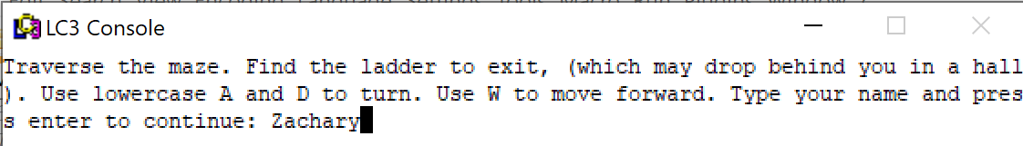
Introduction
Print greeting to player
Ask for user name
Used to generate a “random” starting position and a “random” position for the exit

Slide 6
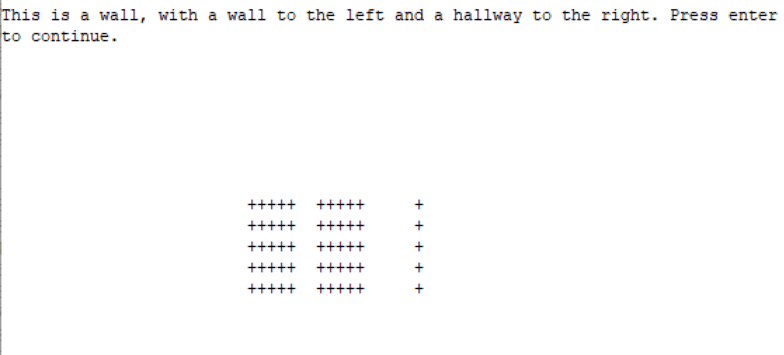
Introduction
Examples

Slide 7
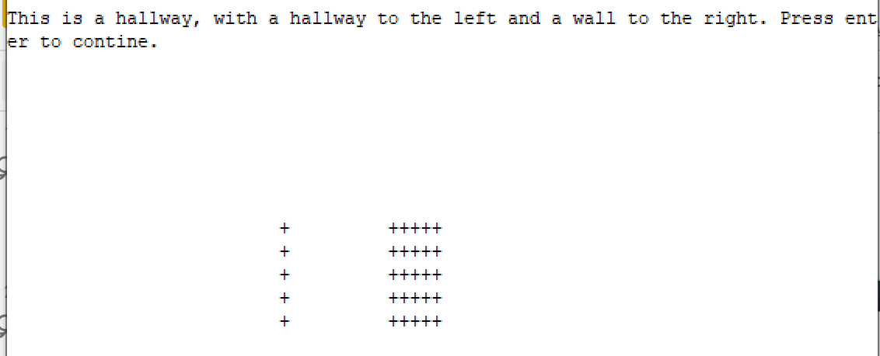
Introduction
Examples

Slide 8
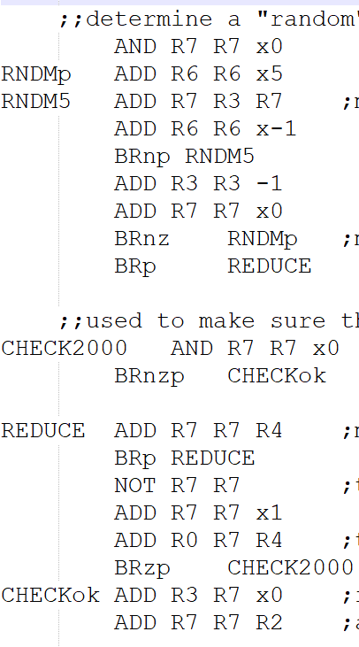
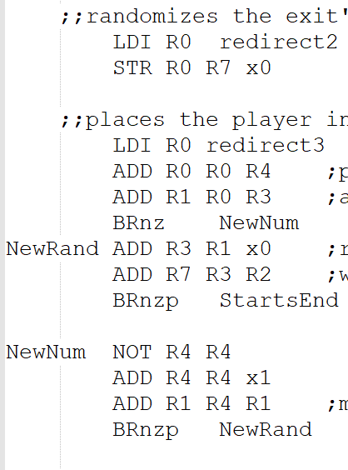
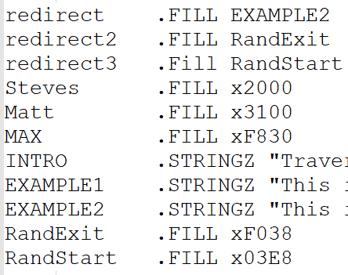
Introduction
“Randomize” starting position and maze exit

Slide 9
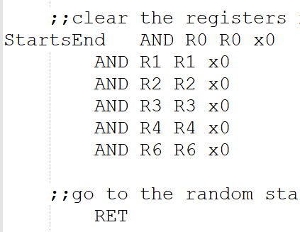
Introduction
Clear registers for the rest of the maze
Goes to “random” starting position

Slide 10
Introduction - Bugs and Roadblocks
Randomizing the start
Multiple of 5
Making sure to jump to code within the maze
Randomizing the exit
Lengthy Introduction code
Using LDI with a second label
Changing the origin of the maze code

Slide 11
The Maze

Slide 12
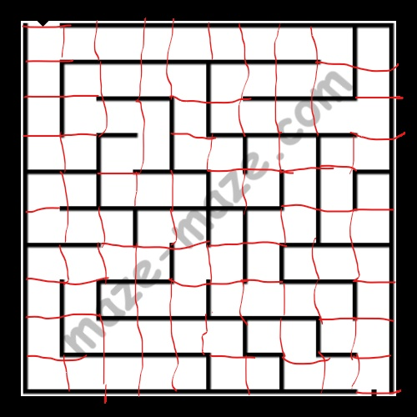
The Maze
Use repeating 5 lines of code, we called “blocks”
Use labels to connect the different parts of the maze
Location-Row-Column-Direction
Ex. L14N
Every square needs 4 blocks of code
Maze is 10 x 10 square
Ensure BR can reach every square it’s touching

Slide 13
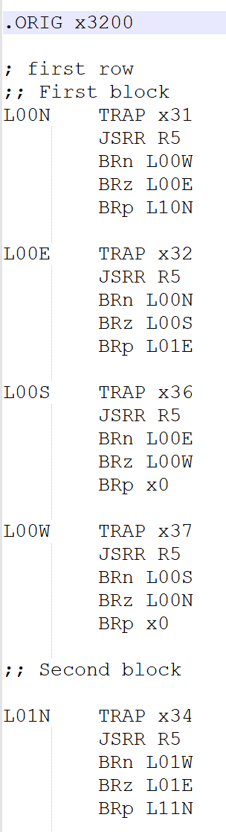
The Maze
TRAPs —> produce an image to the console and determine if a player can move forward or not
JSRR R5 —> Calls the subroutine to accept user input
3 BR —> will move to other parts of the maze based on accepted user input
Randomized exit overwrites ones of the TRAP lines with TRAP x38
Trap x38

Slide 14
The Maze - Bugs and Roadblocks
Lots of code
2000 lines
High amount of accuracy required with changing labels
Had to adjust the BR patterns when arrow keys couldn’t be accepted as input

Slide 15
TRAP Functions

Slide 16
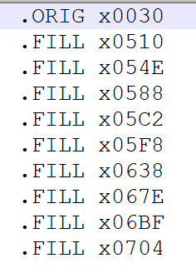
TRAP Functions
Create TRAPs
Write the addresses of the starts of TRAP functions at addresses x0030 through x0038
Write the functions at their proper locations in memory

Slide 17
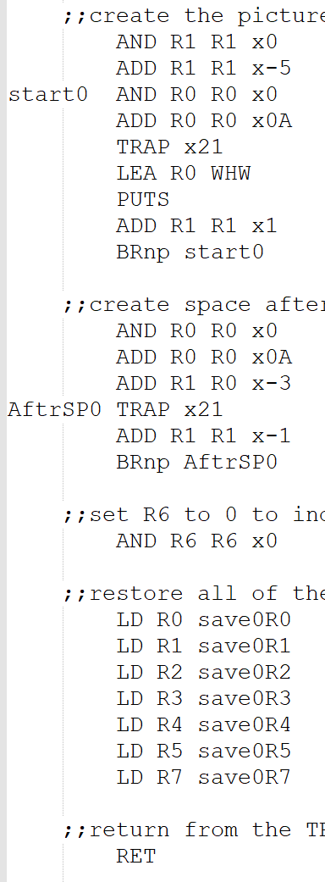
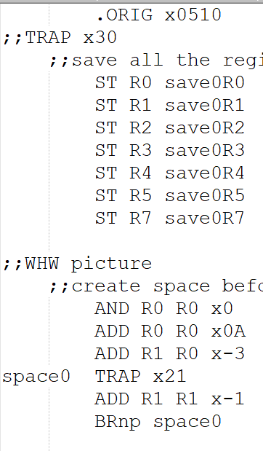
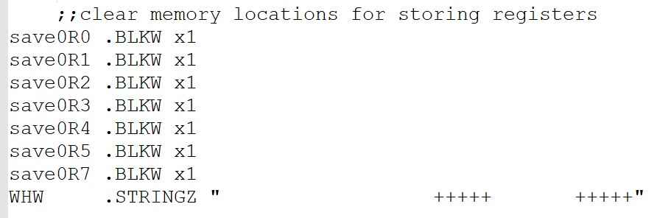
Trap Functions
Save all the registers’ information
Create space before the picture
Create the picture
Create space after the picture
R6 —> determine if wall is ahead or exit
Restore the registers’ information
Return to the location from which the TRAP was called

Slide 18
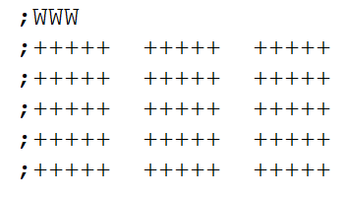
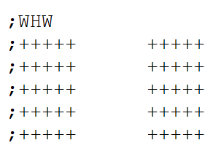
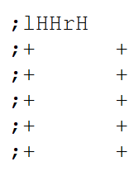
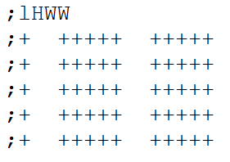
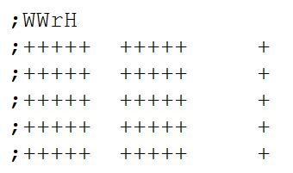
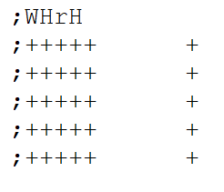
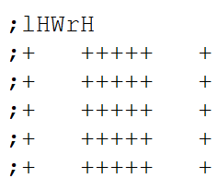
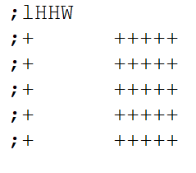
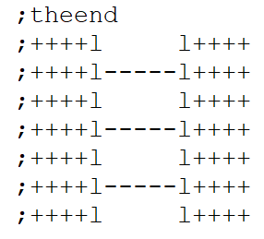
TRAP pictures

Slide 19
TRAP Functions
When a wall is ahead
R6 —> set to 1
When no wall is ahead
R6 —> set to 0
When facing the exit
R6 —> set to 2

Slide 20
TRAP Functions - Bugs and Roadblocks
Had to write the subroutines before inputting their addresses in the TRAPs memory locations
Had to create 9 different images/subroutines
Had to be created before The Maze code could be completed

Slide 21
Accepting Input

Slide 22
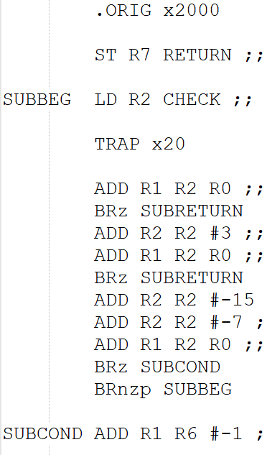
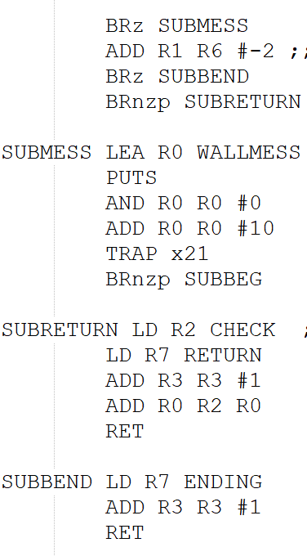
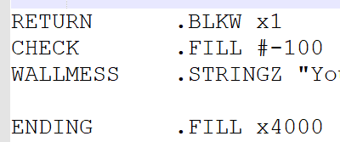
Accepting Input
Store R7 to return to maze
Allows use of TRAPs
Check for “a”, “d”, or “w” input
When “w” is pressed, check for wall, and check for exit
Send message if walking into a wall
Add -100 (the negative of ASCII for “d”) to accepted input
Produces a negative, zero, or positive CC
This determines which branch to take
If facing exit, “w” will take user to the end code

Slide 23
Accepting Input
Bugs and Roadblocks
Step counter
Ran out of time to convert steps stored in Hexadecimal into decimal notation
Discovered LC-3 won’t accept arrow key inputs
Had to change accepted input to “a”, “w”, and “d”

Slide 24
Ending

Slide 25
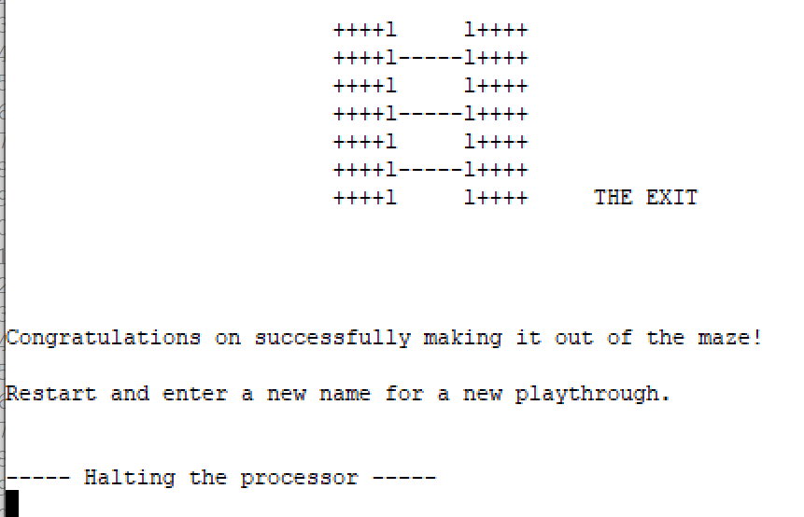
Ending
Produces a message congratulating the player on a successful playthrough
Couldn’t convert hexadecimal number to decimal number

